Slide 1
Used Car Price Prediction Project Presentation
Submitted by GOPABANDHU SAHOO

Slide 2
ACKNOWLEDGMENT
I would like to express my deepest gratitude to my SME (Subject Matter Expert) Mohd Kashif Sir as well as Flip Robo Technologies who gave me the opportunity to do this project on Used Car Price Prediction, which also helped me in doing lots of research wherein I came to know about so many new things especially the data collection part.
Also, I have utilized a few external resources that helped me to complete the project. I ensured that I learn from the samples and modify things according to my project requirement.

Slide 3
PROBLEM STATEMENT
With the covid 19 impact in the market, we have seen lot of changes in the car market. Now some cars are in demand hence making them costly and some are not in demand hence cheaper. One of our clients works with small traders, who sell used cars. With the change in market due to covid 19 impact, our client is facing problems with their previous car price valuation machine learning models. So, they are looking for new machine learning models from new data. We have to make car price valuation model.

Slide 4
MODEL BUILDING PHASE
After collecting the data, you need to build a machine learning model. Before model building do all data pre-processing steps. Try different models with different hyper parameters and select the best model. Follow the complete life cycle of data science. Include all the steps below.
1. Data Cleaning
2. Exploratory Data Analysis
3. Data Pre-processing
4. Model Building
5. Model Evaluation
6. Selecting the best model

Slide 5
DATA PREPROCESSING
Importing the necessary dependencies and libraries.
Reading the CSV file and converted into data frame.
Checking the data dimensions for the original dataset.
Looking for null values and accordingly fill the missing data.
Checking the summary of the dataset.
Checking unique values.
Checking all the categorical columns in the dataset.

Slide 6
DATA PREPROCESSING
Visualizing each features using matplotlib and seaborn.
Performing encoding using the ordinal encoder on categorical features.
Checking for co-relation/multi-collinearity in a heatmap.
Checking for Outliers/Skewness using boxen plot and distribution plot.
Perform Scaling using Standard Scaler method.
Checking for the final dimension of dataset to confirm the input details.
Creating train test split and the best random state found in the range 1-1000.

Slide 7
EXPLORATORY DATA ANALYSIS (EDA)
First I have imported the necessary libraries and loaded the entire dataset in our Jupyter Notebook and renamed the project file from untitled.
Then I checked the shape of our dataset and found that we have a total of 10,000 rows and 6 different columns.
We don’t have any null values or missing values present in our dataset from the web scraping.
There few duplicate rows/records in our dataset but I decided to retain them instead of deleting it.
By checking the data types I came to know that our data set consists of columns having only object datatype even those there were numeric information present.

Slide 8
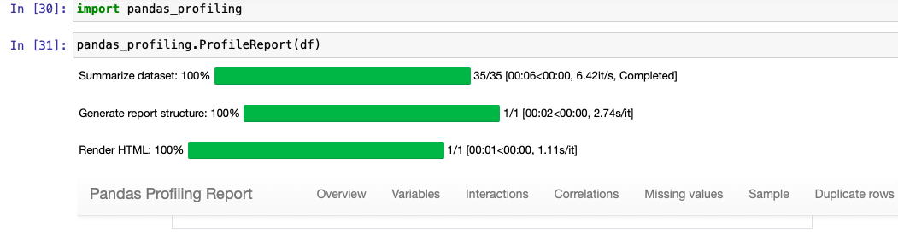
VISUALIZATION USING PANDAS PROFILING REPORT

Slide 9
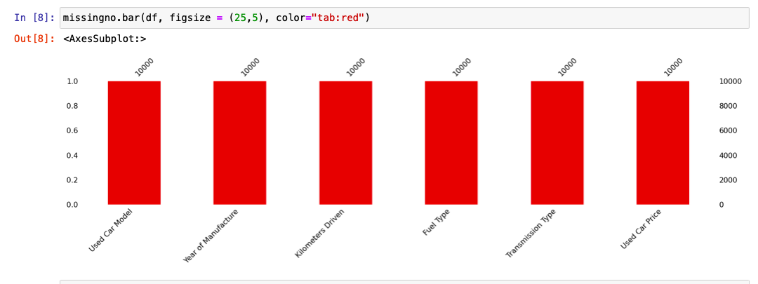
MISSING VALUES VISUAL USING MISSINGNO

Slide 10
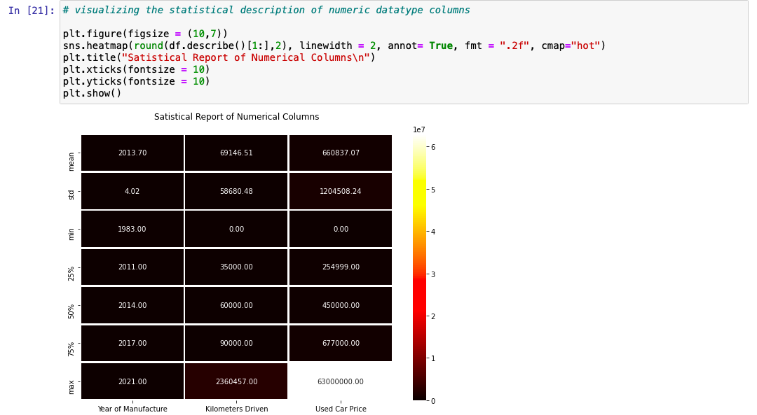
DESCRIBE DATASET VISUAL ON NUMERIC DATA

Slide 11
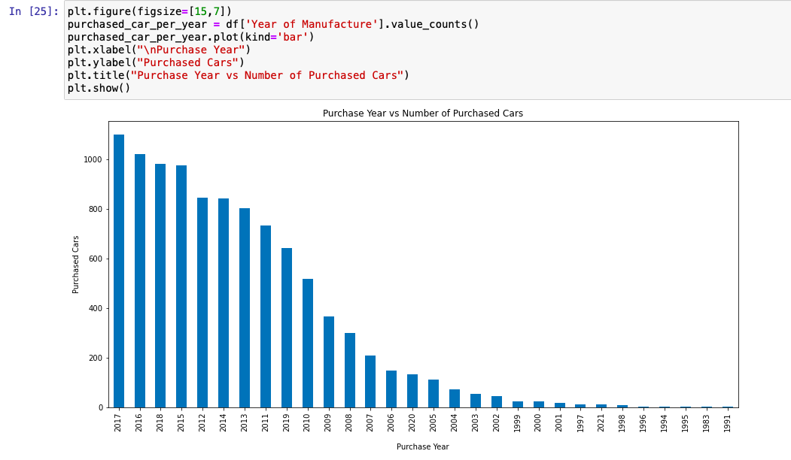
PURCHASE DETAILS OF USED CARS EACH YEAR

Slide 12
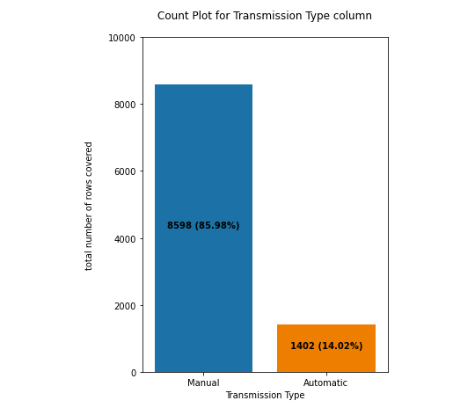
COUNT PLOTS

Slide 13
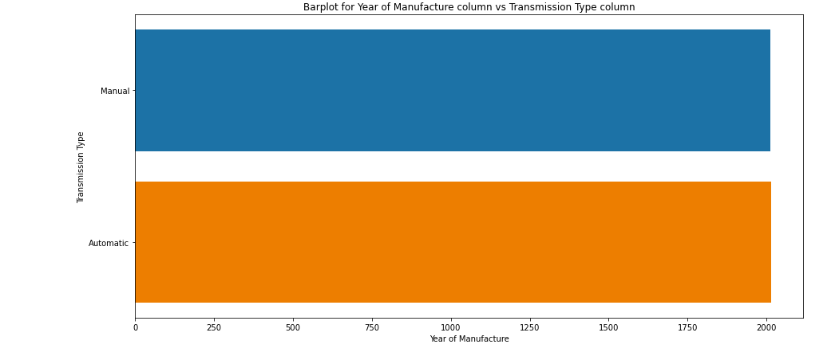
BAR PLOTS

Slide 14
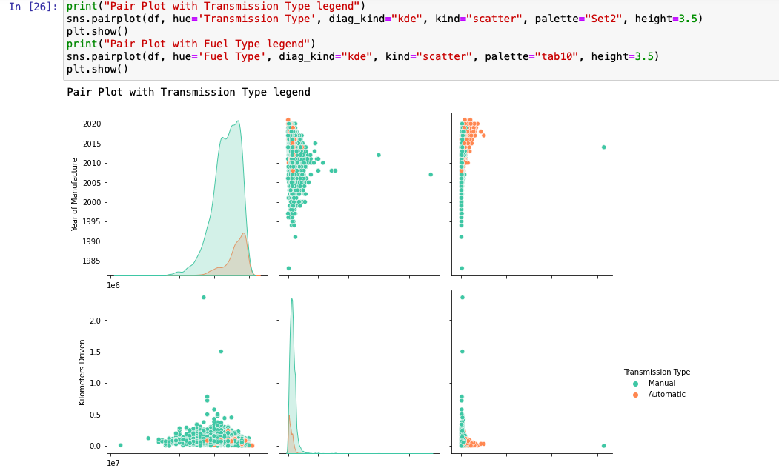
PAIR PLOTS

Slide 15
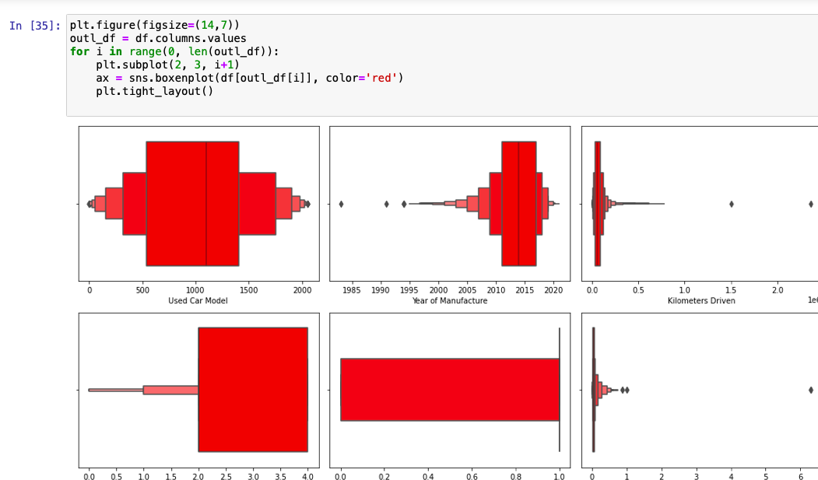
OUTLIERS WITH BOXEN PLOTS

Slide 16
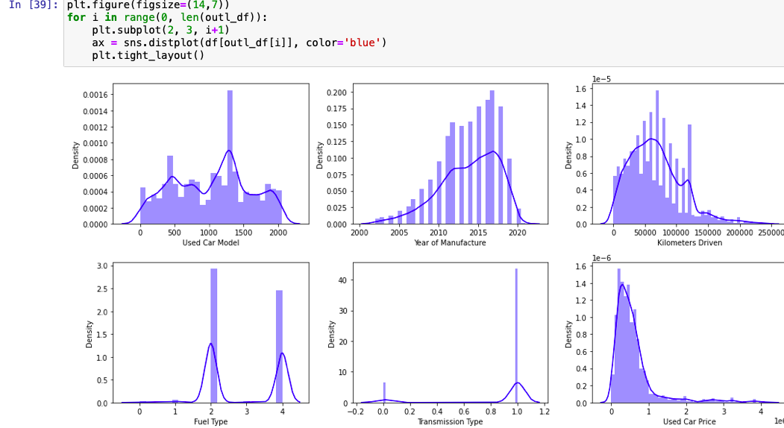
SKEWNESS WITH DISTRIBUTION PLOTS

Slide 17
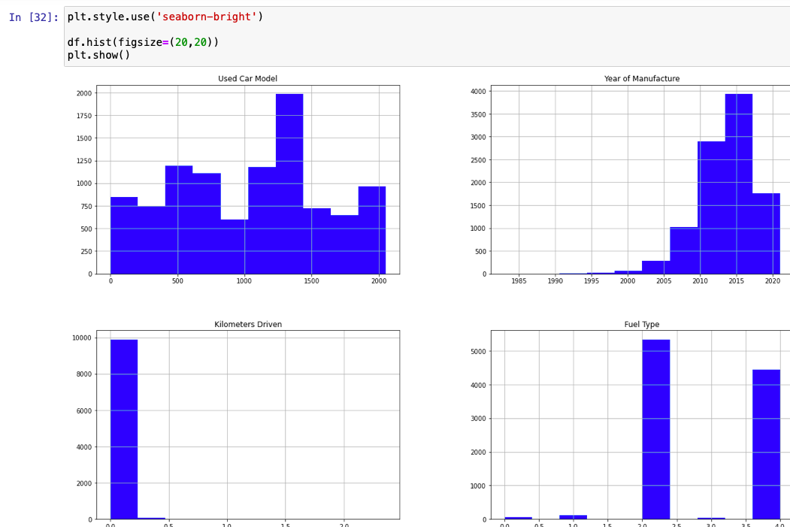
HISTOGRAM

Slide 18
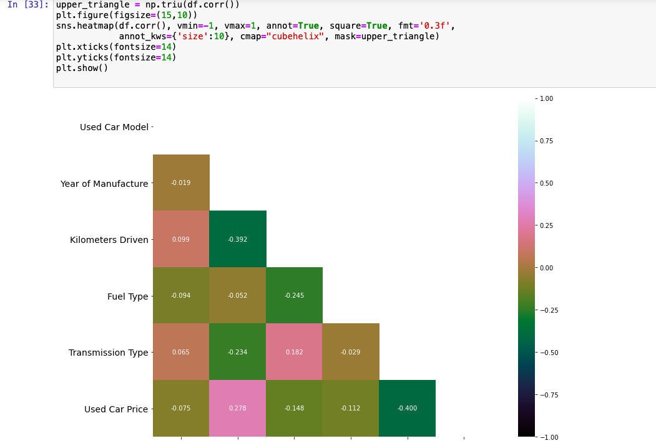
HEATMAP

Slide 19
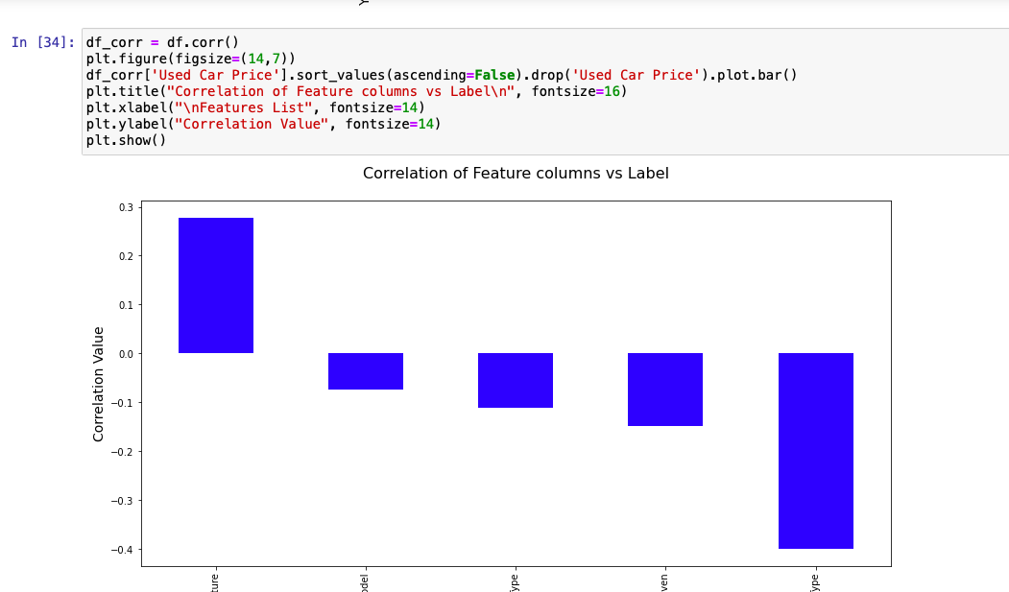
CORRELATIONS BAR GRAPH

Slide 20
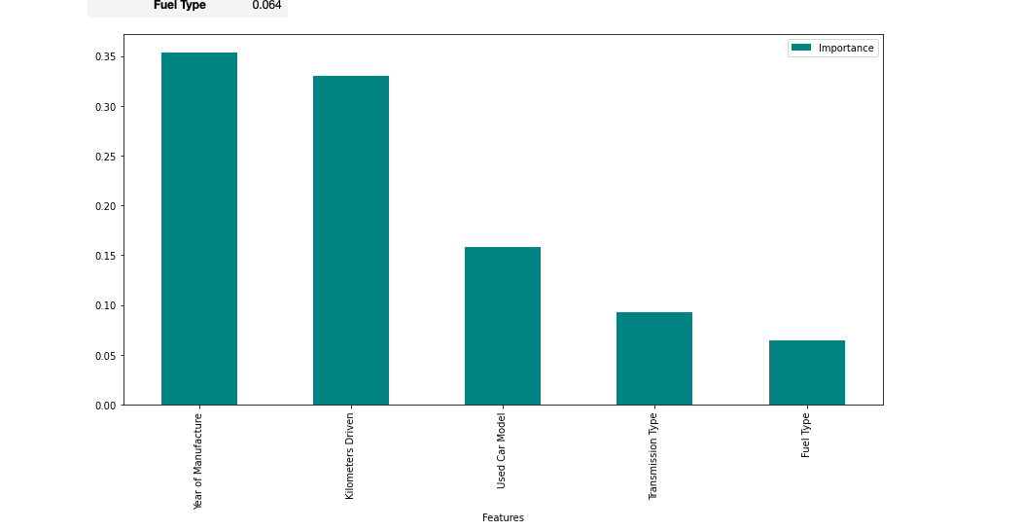
FEATURE IMPORTANCE BAR GRAPH

Slide 21
REGRESSION MACHINE LEARNING MODEL/S USED
▪ Linear Regression Model
▪ Ridge Regularization Model
▪ Lasso Regularization Model
▪ Support Vector Regression Model
▪ Decision Tree Regression Model
Random Forest Regression Model
▪ K Neighbours Regression Model
▪ Gradient Boosting Regression Model
▪ Ada Boost Regression Model
▪ Extra Trees Regression Model

Slide 22
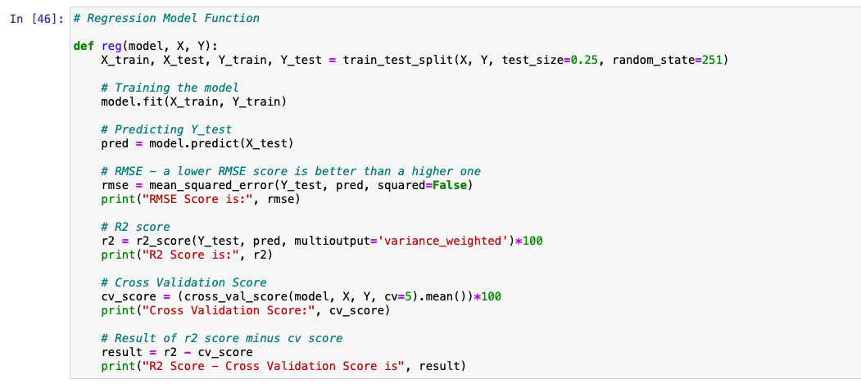
REGRESSION MODEL FUNCTION WITH EVALUATION METRICS

Slide 23
EVALUATION AND HYPER PARAMETER TUNING
The key metrics used here were:
R2 score
Cross Validation Score
MAE
MSE
RMSE
We tried to find out the best parameters list to increase our accuracy scores by using Hyperparameter Tuning. In order to achieve a higher score we used the Grid Search CV method with 5 folds.

Slide 24
CONCLUSION
After the completion of this project, we got an insight on how to collect data, pre-processing the data, analyzing the data and building a model. First, we collected the used cars data from different websites like OLX, Car Dekho, Cars 24, OLA etc. and it was done by using Web Scraping.
The framework used for web scraping was Beautiful Soup and Selenium, which has an advantage of automating our process of collecting data. We collected almost 10000 of data which contained the selling price and other related features of used cars. Then the scrapped data was combined in a single data frame and saved in a csv file so that we can open it and analyze the data.

Slide 25
LIMITATIONS OF THIS WORK AND SCOPE FOR FUTURE WORK
The limitations we faced during this project were:
The website was poorly designed because the scrapping took a lot of time and there were many issues in accessing to next page. Also need further practice in terms of various web scraping techniques. More negative correlated data were present than the positive correlated one's. Presence of outliers and skewness were detected and while dealing with them we had to lose a bit of valuable data. No information for handling these fast-paced websites were provided so that was consuming more time in web scraping part.
Future Work Scope:
Current model is limited to used car data but this can further be improved for other sectors of automobiles by training the model accordingly. The overall score can also be improved further by training the model with more specific data.

